Slide 1

Introducing EchoEase
Breathing New Life into Respiratory Care

Slide 2

Problem
“Patients in LMIC settings are often Under Diagnosed and Under Treated.”
There is Lack of Timely Monitoring
Existing Self Monitoring Solutions are not Accessible and Affordable
High Cost of Treatment and Hospitalization

Slide 3

Market Validation
Total Available Market (TAM)
628.5 Million
Individuals
Number of Individuals suffering from Asthma and Chronic Obstructive Pulmonary Disease
Serviceable Available Market (SAM)
94.275 Million Individuals
Based on expert opinions and surveys, this segment is predicted to be 15% of the Total Adressable Market
Serviceable Obtainable Market (SOM)
47.138 Million Individuals
This figure represents the market when can realistically capture and service in the short - medium run

Slide 4




Solution
A mobile phone app that empowers individuals by,
Real Time Tracking and Assessment
Early Detection and Continuous Self Monitoring Capabilities
Simple and User Friendly Interface
Global Accessibility and Affordability

Slide 5

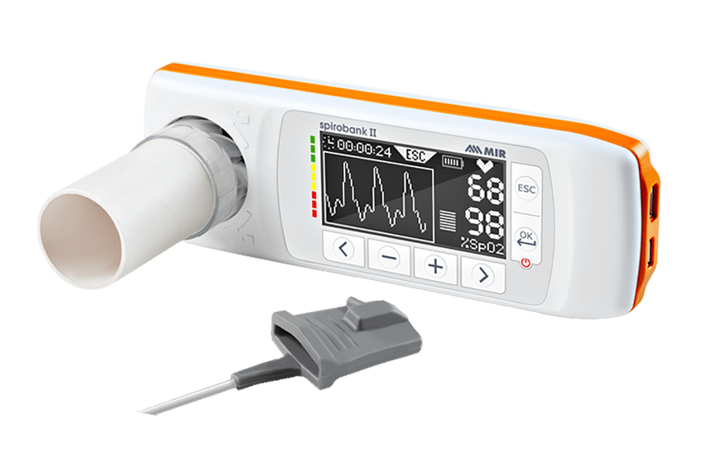
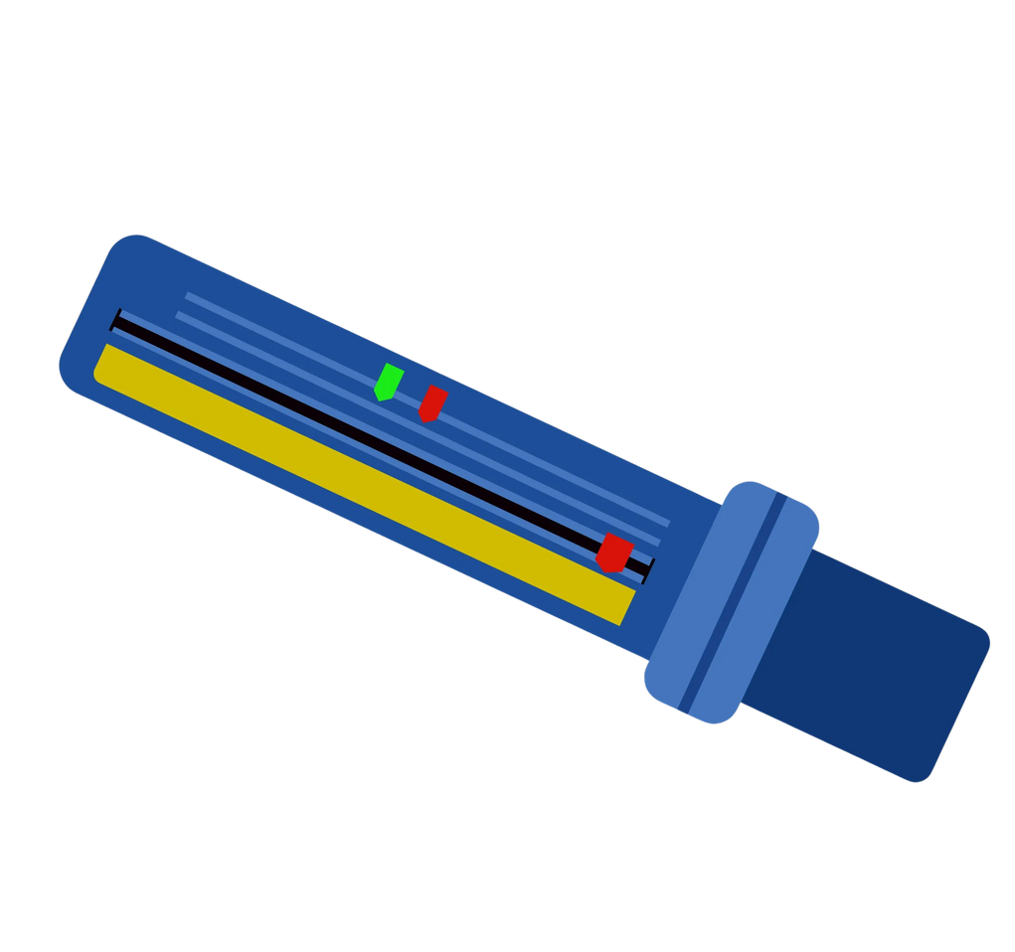
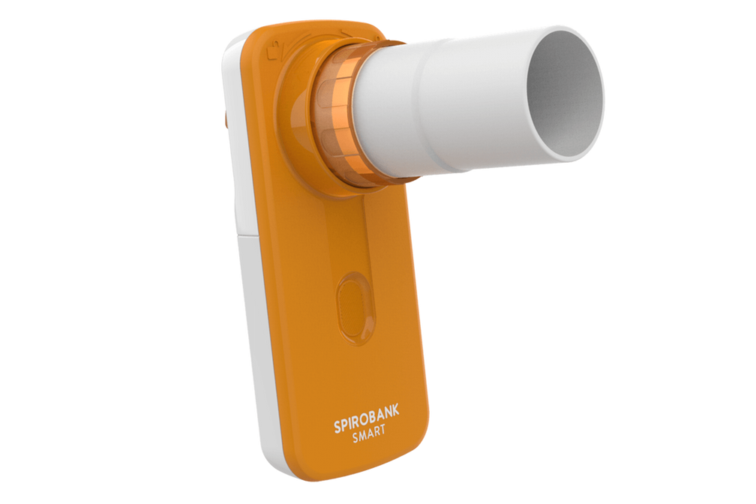
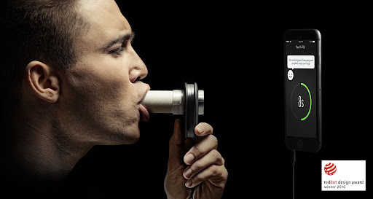
PRE-EXISTING
SOLUTION

Slide 6

-ABHIJEET DESHMUKH

Slide 7

-VBOOKSHELF

Slide 8
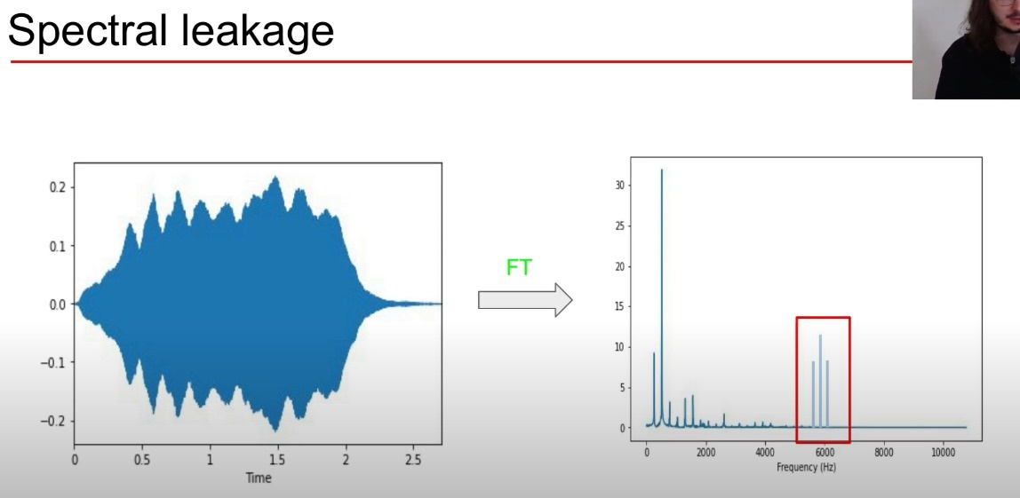
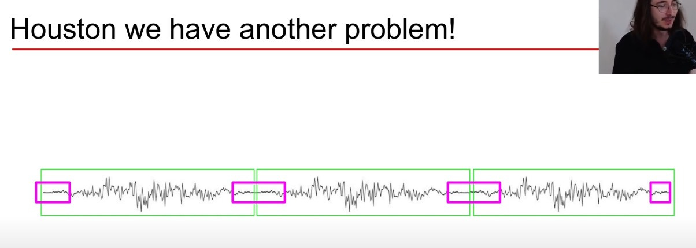
We have another problem
Spectral Leakage

Slide 9
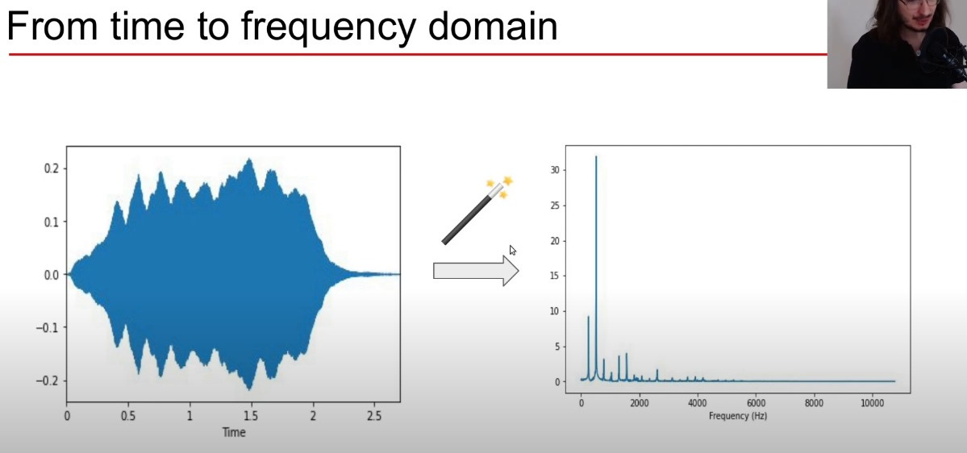
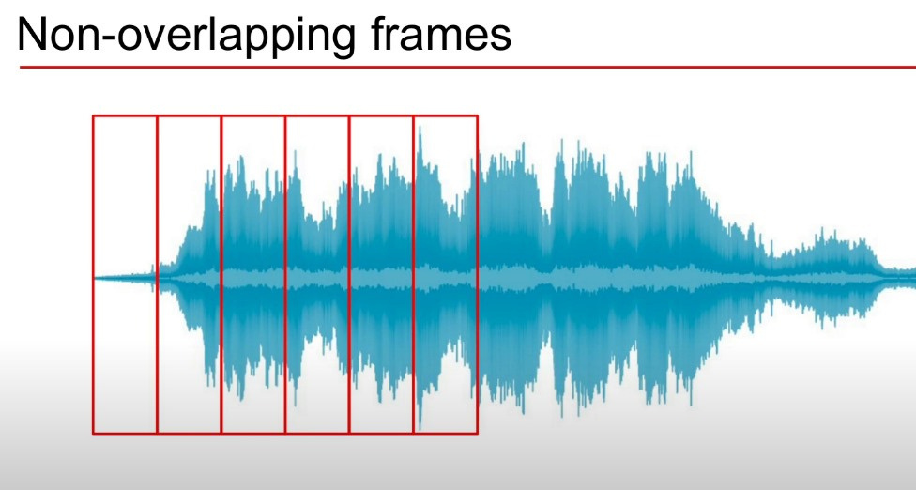
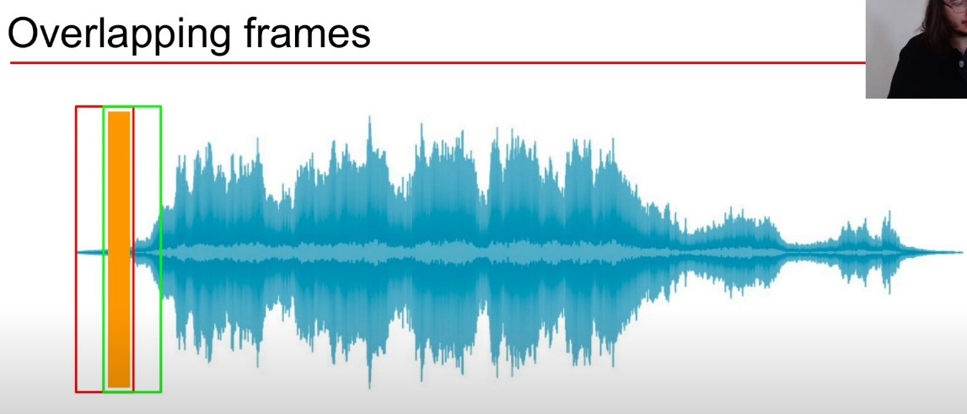
Time To Frequency Domain
Non Overlapping Frames
Overlapping Frames

Slide 10

Features
Mel-Frequency Cepstral Coefficients
Spectral Centroid
Spectral Rolloff
Zero Crossing Rate
Delta MFCC (mean)
Wavelet Mean & STD
Linear Predictive Coding (mean)
Chroma STFT
Root Mean Square Energy

Slide 11
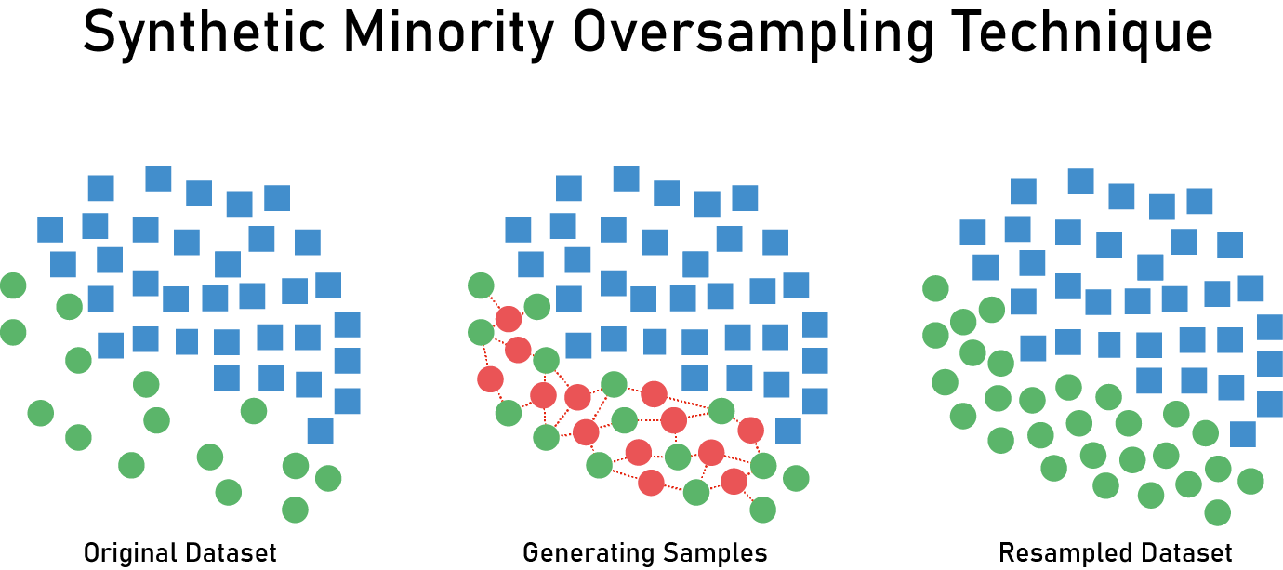
SMOTE
Synthetic Minority Oversampling Technique
statistical technique that helps balance under sampling
generates new instances from existing minority
Oversamples our minority classes (asthma & COPD)
Original Dataset
Generating Samples
Resampled Dataset

Slide 12
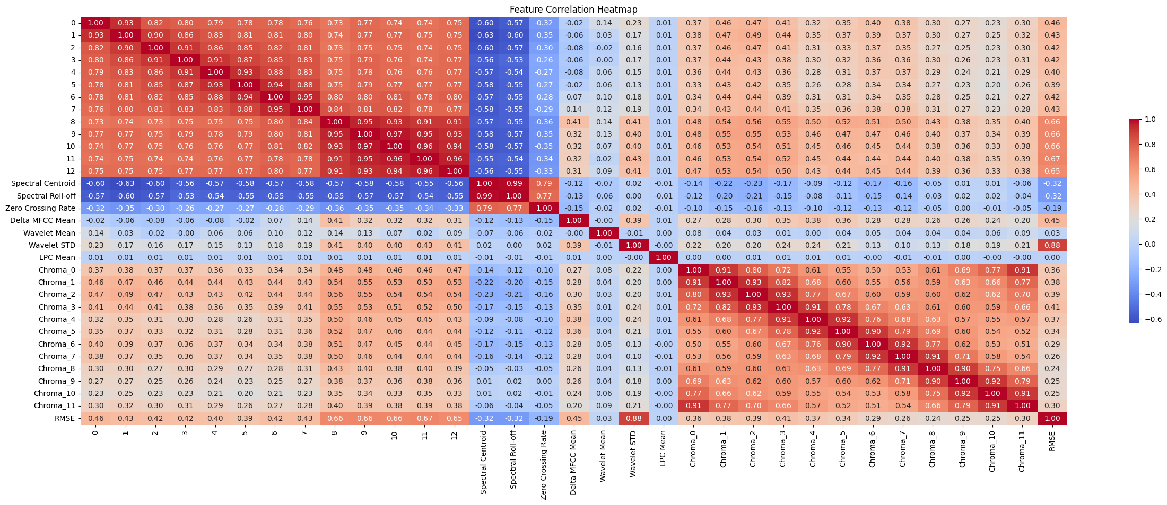
Feature Correlation Heatmap

Slide 13
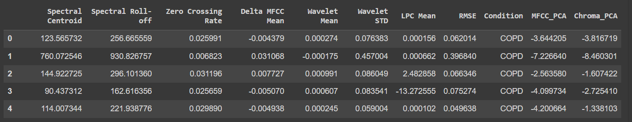
PCA
Principal Component Analysis
we saw that the MFCC and Chroma Features have really high correlation
so we use PCA to combine them

Slide 14
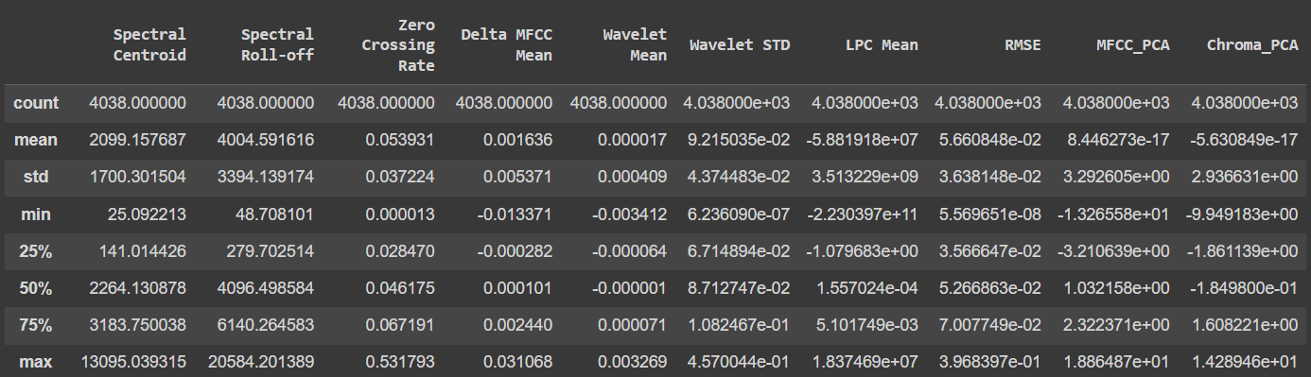
Statistical Summary

Slide 15
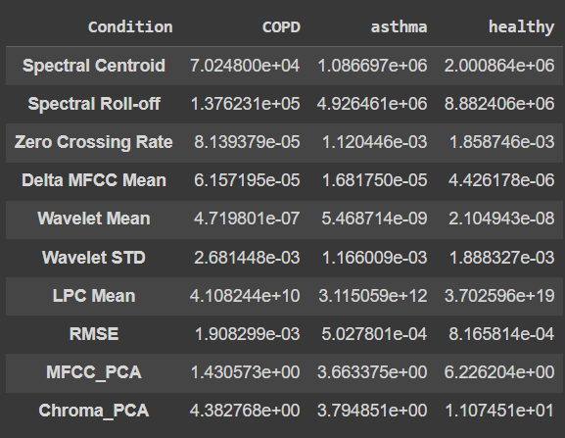
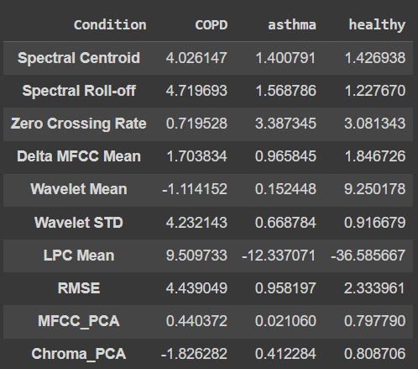
Variance
Skewness

Slide 16
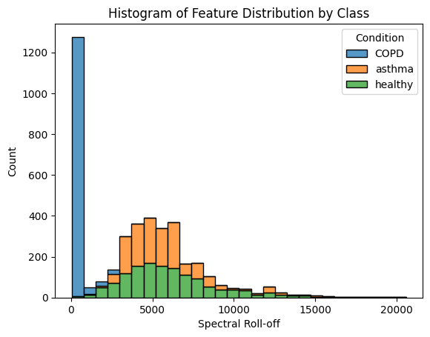
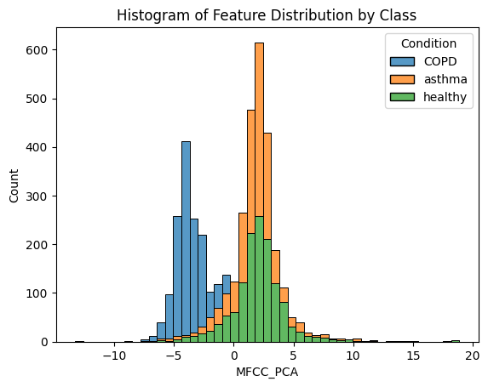
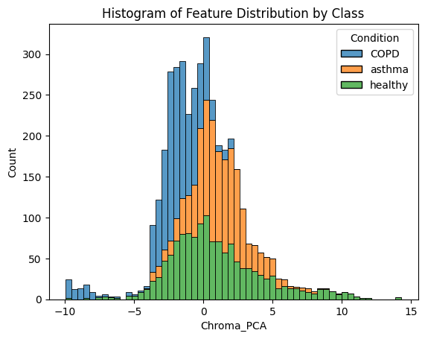
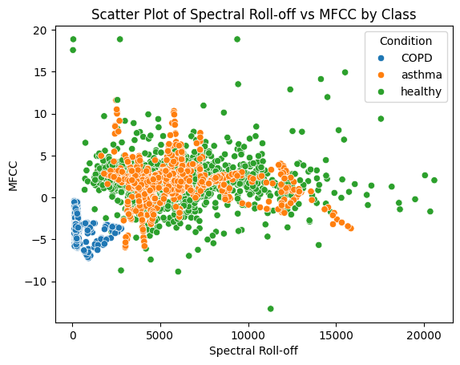
Spectral Roll-off
MFCC_PCA
Chroma_PCA
Spectral Roll-off

Slide 17
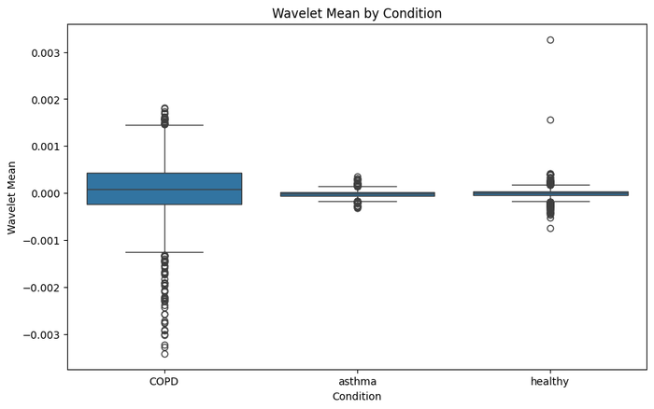
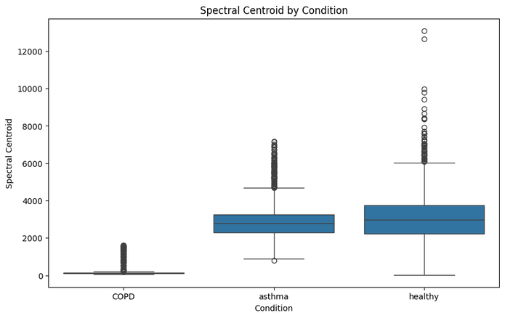
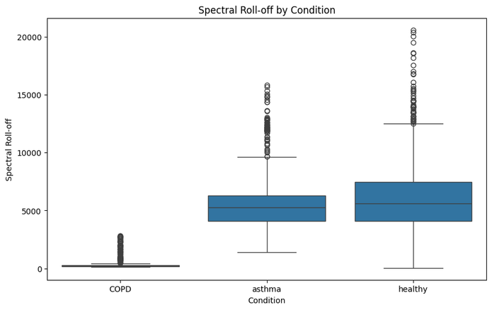
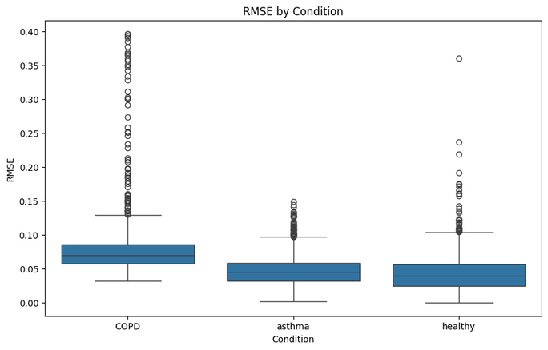
Wavelet mean
Spectral Centroid Condition
Spectral Roll-off
RMSE

Slide 18
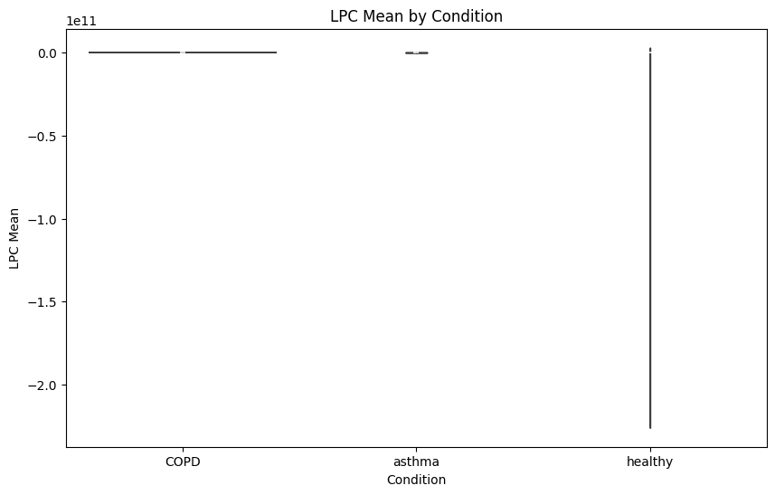
LPC Mean

Slide 19



Models
Decision Tree
Accuracy: 0.8613861386138614
Gradient Boosting Machine
Accuracy: 0.8960396039603961

Slide 20


Models
Decision Tree
Accuracy: 0.8613861386138614
Gradient Boosting Machine
Accuracy: 0.8960396039603961

Slide 21


Models
Light GBM
Accuracy: 0.9306930693069307
Voting Ensemble
Accuracy: 0.9220297029702971

Slide 22

Models
Bigger Voting Ensemble
Accuracy: 0.926980198019802

Slide 23

MS AZURE AUTOMATED ML

